Slide 1
1st North West Orthopaedic Oncology Course
Welcome!

Slide 2
Overview
Provide an overview of common MSK oncology pathology, how to assess & manage it and principles of management
Prepare for the FRCS
Develop awareness and understanding

Slide 3
Housekeeping
No Fire drills planned
Food and drink provided
Toilets
Starbucks on other side of car park
Stay till end for your certificate
Presentation will be made available via web link
Questions till after presentation

Slide 4
Agenda
Morning
Musculoskeletal Tumour Overview
Soft Tissue Sarcomas
Coffee & Sponsors
Bone Tumours
Lunch

Slide 5
Agenda
Afternoon
Metastatic Bone Disease
Coffee
Vivas / Cases
Close around 4ish

Slide 6
VIVA sessions
3 tables:
Soft Tissue tumours
Bone tumours
Metastatic Bone Disease
Groups of doctors and AHP’s

Slide 7
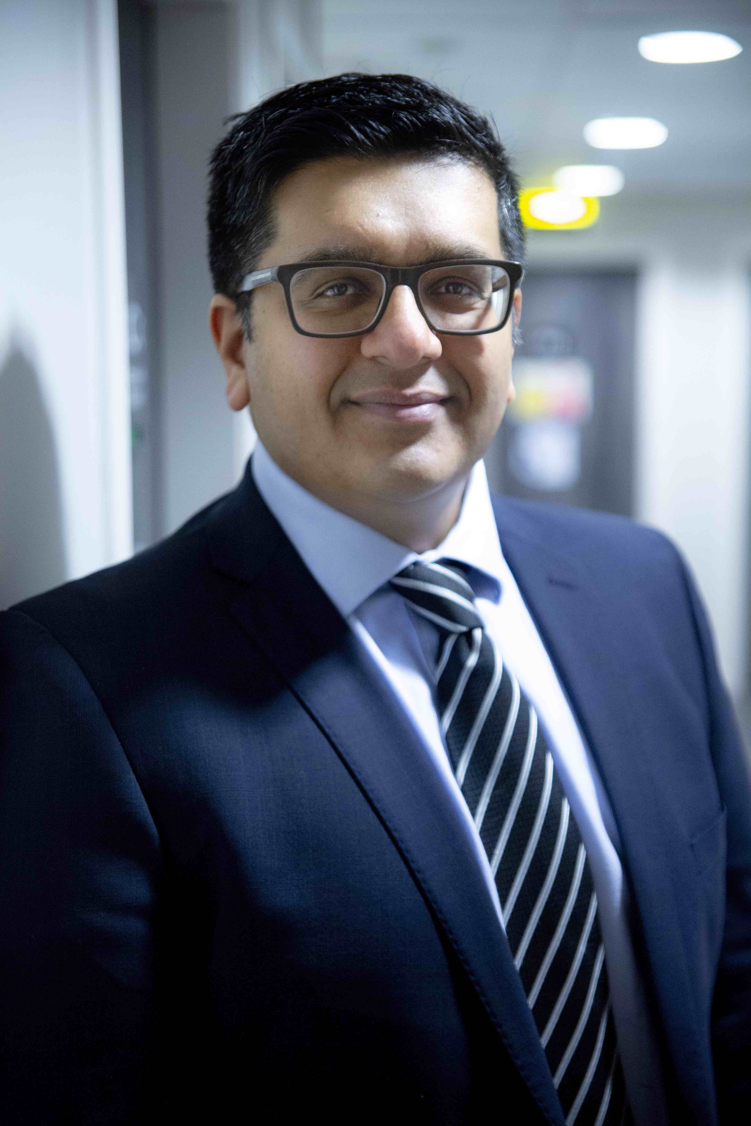
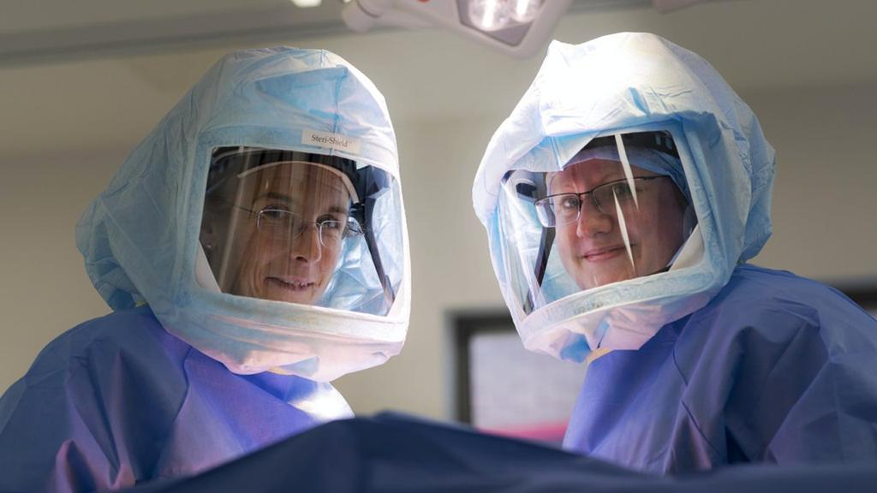
Speakers
Amit Kumar
Consultant Orthopaedic & Oncological Surgeon, MFT & GMOSS
Clinical Director Sarcoma GM Cancer
SAG Chair
Gillian Cribb &
Karen Shepherd
Consultant Orthopaedic & Oncological Surgeons
RJAH & GMOSS

Slide 8
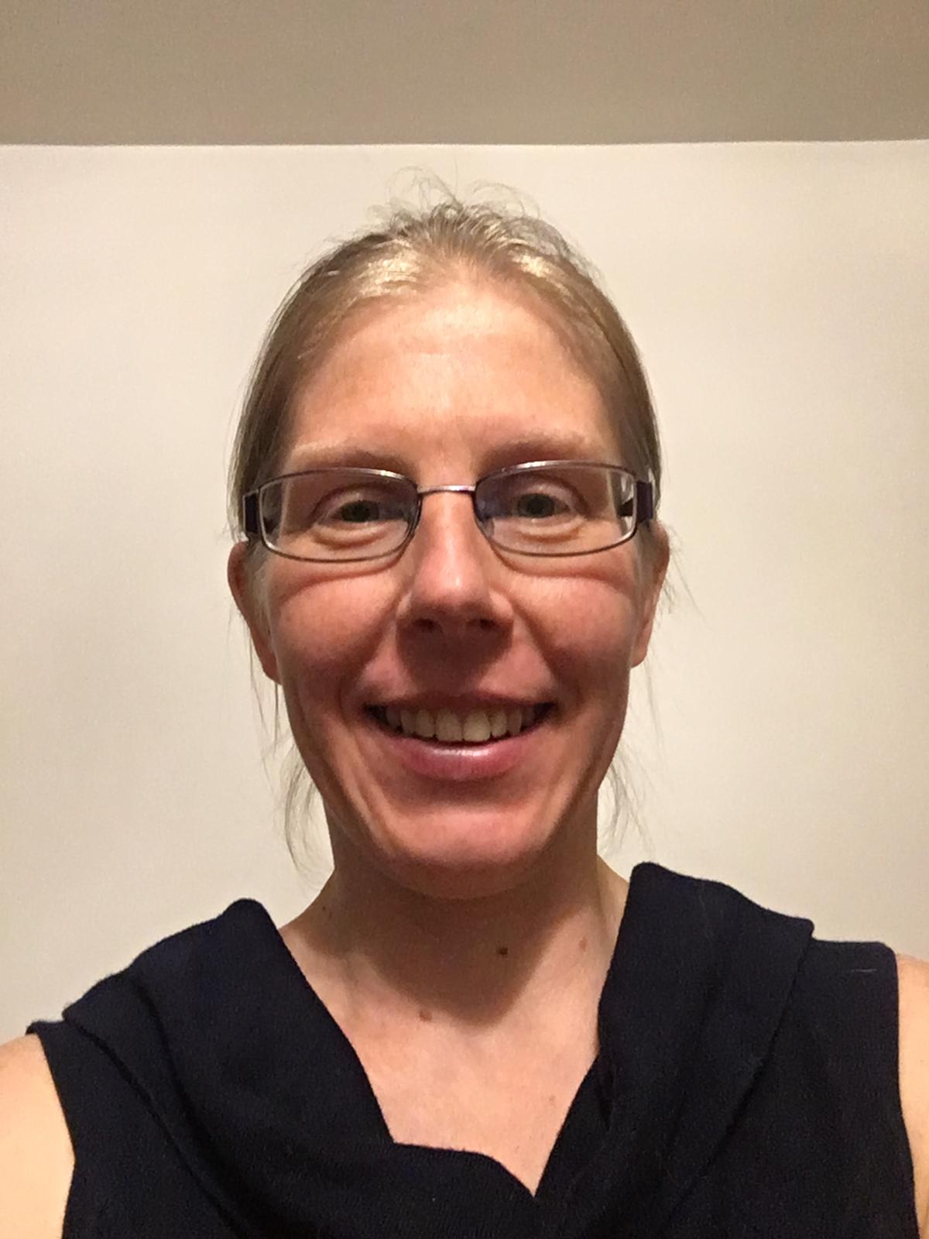
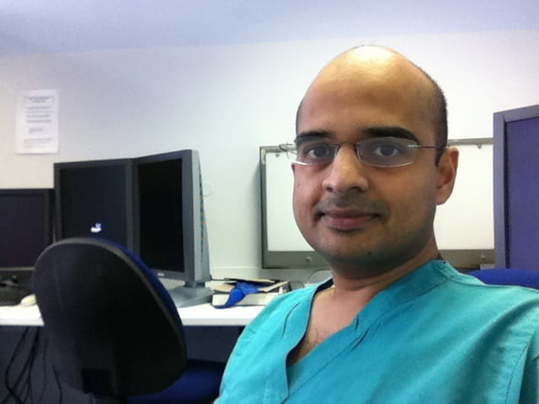
Dr Katalin Boross
Consultant Histopathologist
Dr Shubhang Kulkarni
Consultant Radiologist MFT

Slide 9
Guest Speaker Prof. Robert Ashford
Consultant Orthopaedic & Oncological Surgeon
East Midlands Sarcoma Service
SAG Chair
President British Orthopaedic Oncology Society
ABC Fellow 2014
His trainees have excellent pass rate!

Slide 10
Feedback
Please leave feedback and ask questions!
Twitter: @orthopodkumar
@gilliancribb
Email: amit.kumar@mft.nhs.uk

Slide 11
Summary & Close
Please leave feedback!
Tell your friends
Next years course Friday 16th October 2020 Wythenshawe Hospital
Thank you’s

