Slide 1
Introduction to Database Searches
Trust Library Services
MFT
Elly Aalai

Slide 2
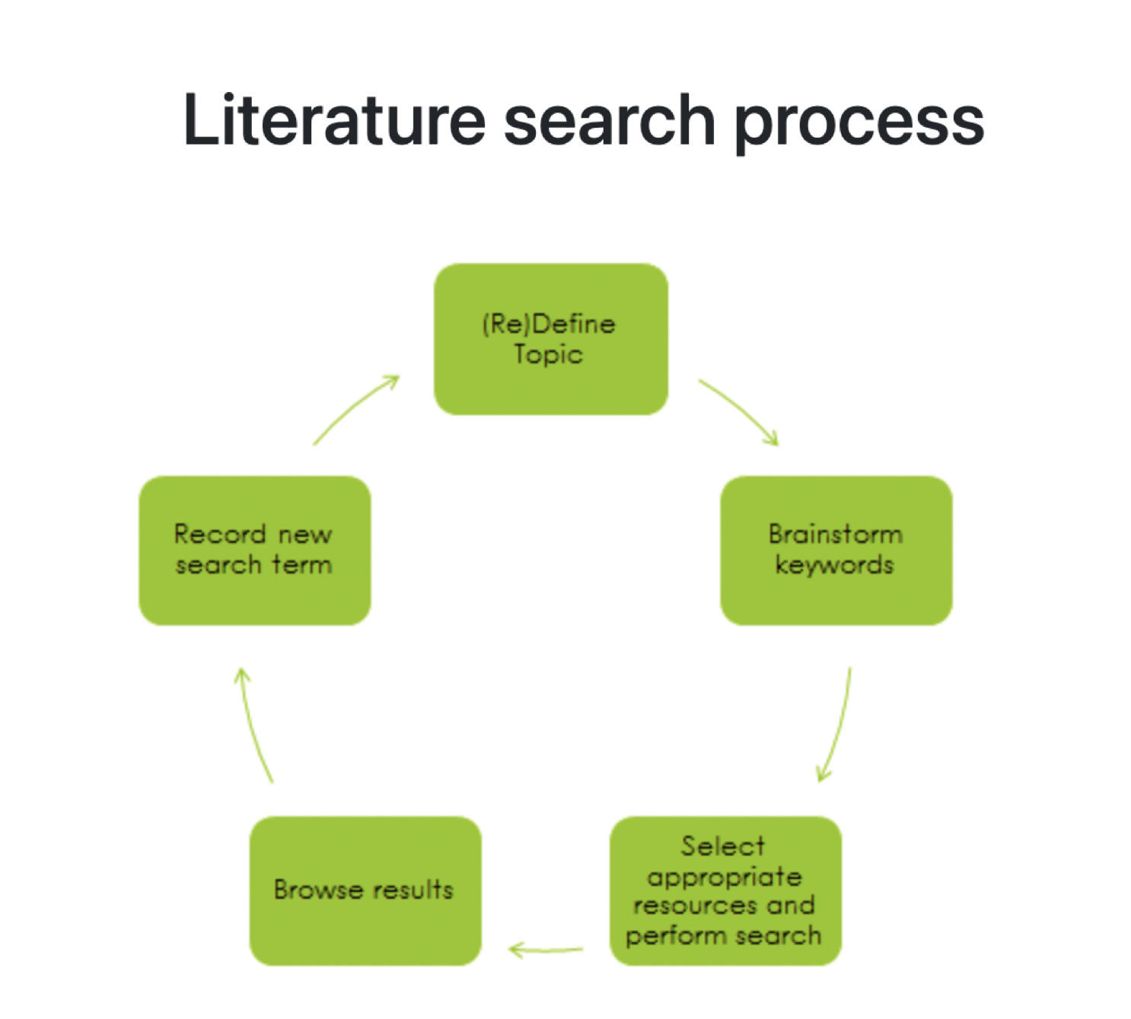

Slide 3
Planning your search
Question: MRSA in NICU
Concept 1 | Concept 2
Neonatal Intensive Care Unit NICU | Methicillin-resistant Staphylococcus aureus
Neonates Neonatology Newborn | MRSA
Special Care Baby Unit
SCBU

Slide 4
Tips and tricks for keyword searching
* = Truncation | Truncation is used when you want to generate as many endings to a term as possible e.g neonat* will bring back neonate/s, neonatal
? = Wildcard | Wildcard is used when you want to search for variations in spelling i.e British vs American e.g p?ediatric, tumo?r
“….” = Phrasing | Phrasing is used when you want to command the database to only search two or more terms in the order you have written them e.g “Special Care Baby Unit*”
n = proximity | Proximity operators can be used to allow some flexibility when searching for two terms. The n represents a number e.g neonat* n3 MRSA will search for variations of the two terms in either word order within 3 words of each other: neonatal MRSA or MRSA in neonates NB: you can use truncation with proximity operators, but you cannot use phrasing

Slide 5
Using keyword operators in your search plan
Concept 1 | Concept 2
“Neonatal Intensive Care Unit*” NICU | “Methicillin-resistant Staphylococcus aureus”
Neonat* Newborn* | MRSA
“Special Care Baby Unit*” SCBU

Slide 6
George Boole and his
Boolean Operators

Slide 7
Boolean Operators
OR = multiplication of terms
OR is used to add synonyms of terms together to create a unique set and broaden your search
e.g ghost OR poltergeist OR spectre
AND = feels like a division of concepts and will narrow results
AND is used to ONLY retrieve articles with both concepts
e.g (ghost OR poltergeist OR spectre) AND (scream OR faint OR cry)
NOT = omission
NOT is used retrieve a set of results, but remove a term you do not wish to see
e.g (ghost OR poltergeist OR spectre) AND (faint OR cry) NOT scream

Slide 8
Using OR and AND in your search plan
Concept 1 | Concept 2
“Neonatal Intensive Care Unit*” | “Methicillin-resistant Staphylococcus aureus”
NICU | MRSA
Neonat* Newborn*
“Special Care Baby Unit*” SCBU
OR
OR
AND
(Unique set 1)
(Unique set 2)

Slide 9
Searching The Thesaurus in Cinahl

Slide 10
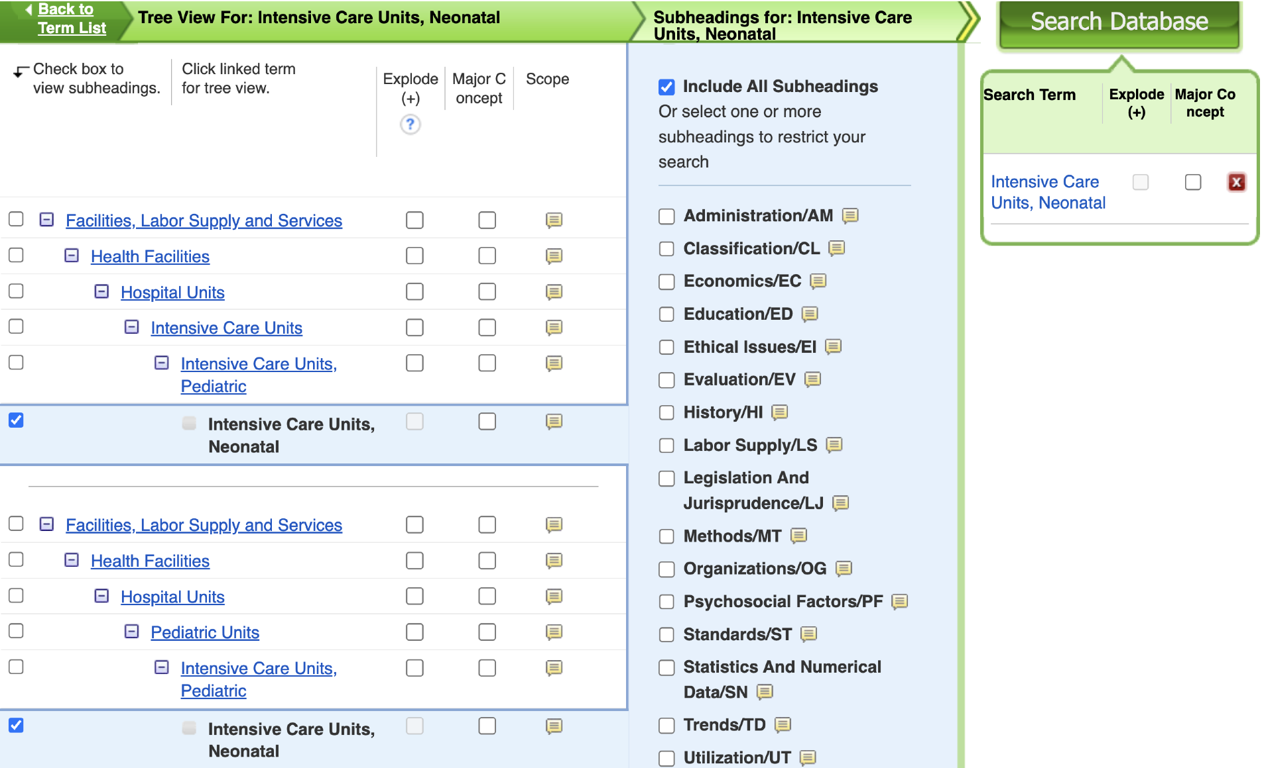
Searching The Thesaurus in Cinahl

Slide 11
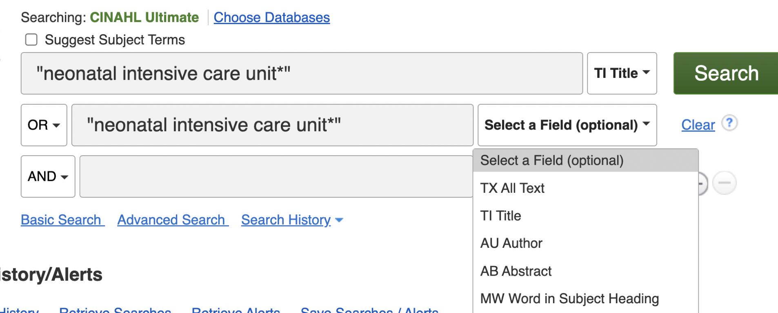
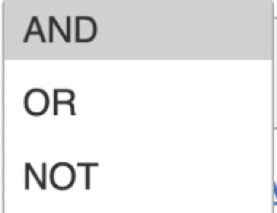
Building your Keyword Sets in Cinahl

Slide 12
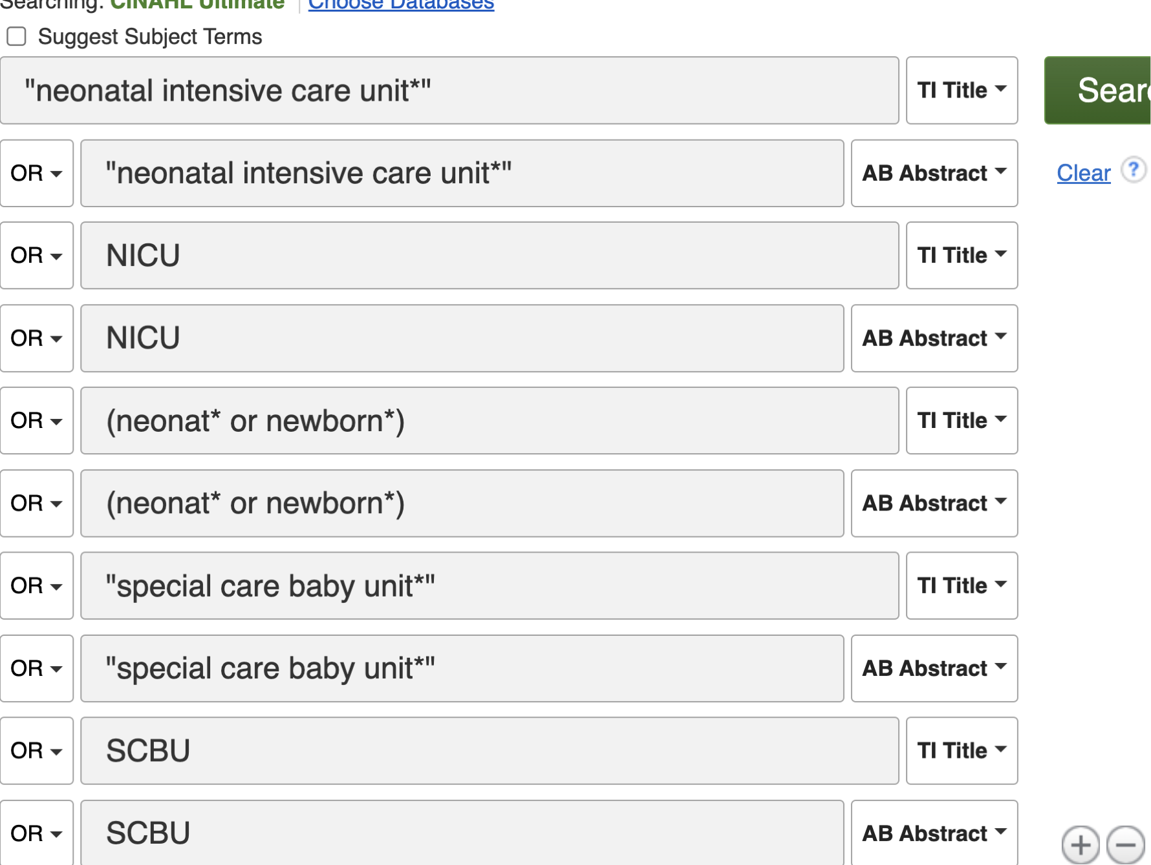
Building your Keyword Sets

Slide 13
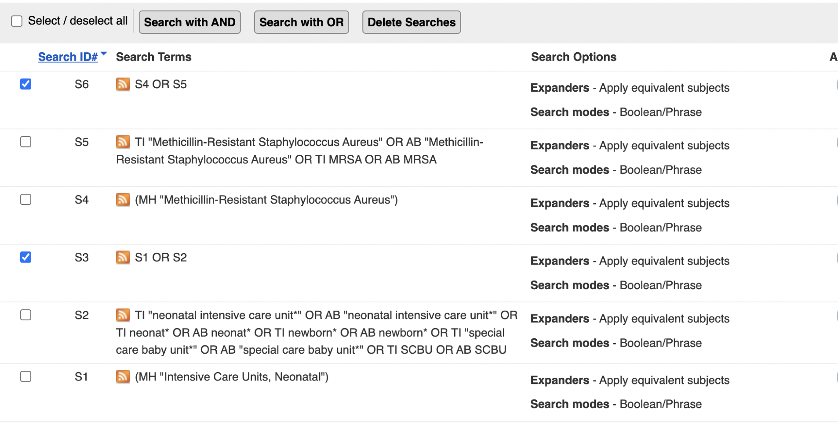
Combining Search Sets in Cinahl

Slide 14
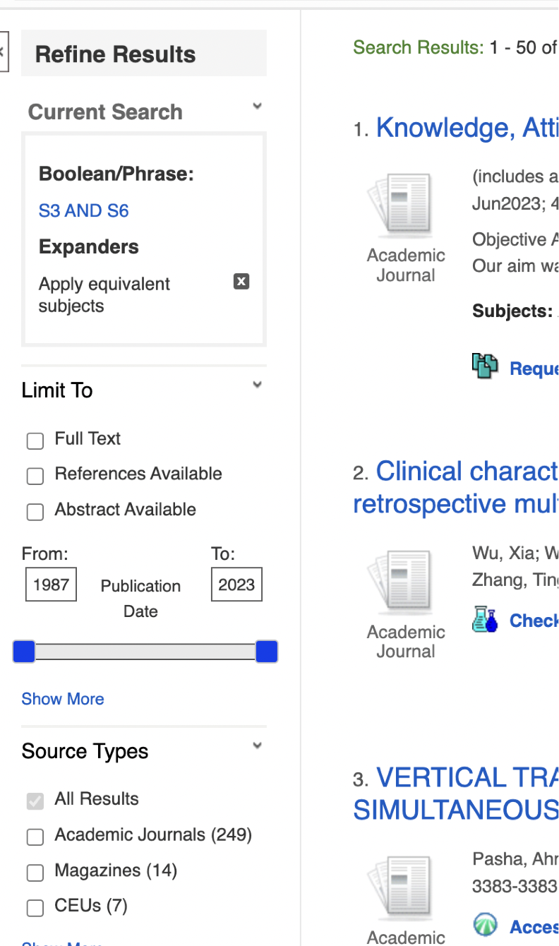
Limiting and Exporting Results in Cinahl

Slide 15
Exporting Search Results in Cinahl

Slide 16
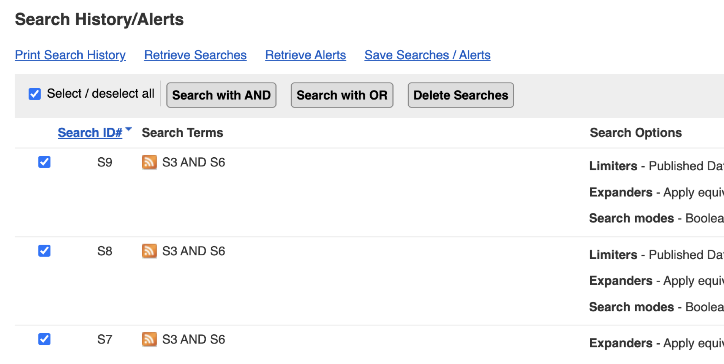
Saving Search Results in Cinahl

Slide 17
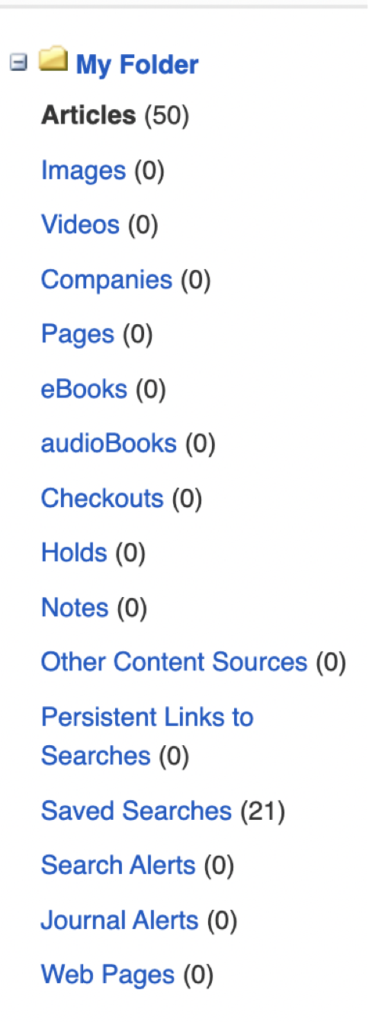
Saving Search Results in Cinahl

Slide 18
Summary
Define your search question
Identify your key concepts
Think about keywords, synonyms, spelling and keyword operators
Select a Database
Conduct your search
Review Results
Health Lizard - https://www.hlisd.org/

